Slide 1
Guide Map Making
E-learning technologies (Unesco) / Final Assignment
Kayako Takagi

Slide 2
Key Concept
Interactive and Connected Learning
In the process, it aims to communicate with others such as group members, other groups and reviewers.
Teacher just functions as a guide to start and support only when learners need help.
Being a member of group and whole project, they tend to have responsibility in a community
Learners are able to gain stronger ties with their native country and city.
Open learning
motivate learners to assess something with good quality
let students see their classmates works and chance to discuss together.
Learning with internal values
Language use in real lives and some of them have an eye on business or professional occasions.
It assists their career formation in the future.

Slide 3
Learning objectives
Improve the Japanese language writing skills of learners in real life occasions.
Gaining advanced level of vocabulary of Japanese language through the reflection of learners’ own culture.
Experiencing communication via online with Japanese native speakers to improve practical skills.

Slide 4
ICT tools
Google my map (main tool, outcomes of activity)
Google form (feedback from classmates and reviewers)

Slide 5
Class / student
Course: Japanese Language Course of Intermediate level
Target: University students
Study environment: Non-Japanese spoken country, few or none of Japanese residence around
Model city: Kaunas

Slide 6
Steps
Students are divided into three groups (city centre, old town and other parts)
Teacher demonstrates the usage of ICT tools (google my map, google form)
Students pin on the shared map and upload photos and short scripts of some spots in their responsible area. (for one week)

Slide 8
Steps
Students are divided into three groups (city centre, old town and other parts)
Teacher demonstrates the usage of ICT tools (google my map, google form)
Students pin on the shared map and upload photos and short scripts of some spots in their responsible area.
Students read other group areas’ descriptions as proofreading of grammars and facts.
Communicate with native Japanese students via online to correct grammars and add more information.

Slide 9
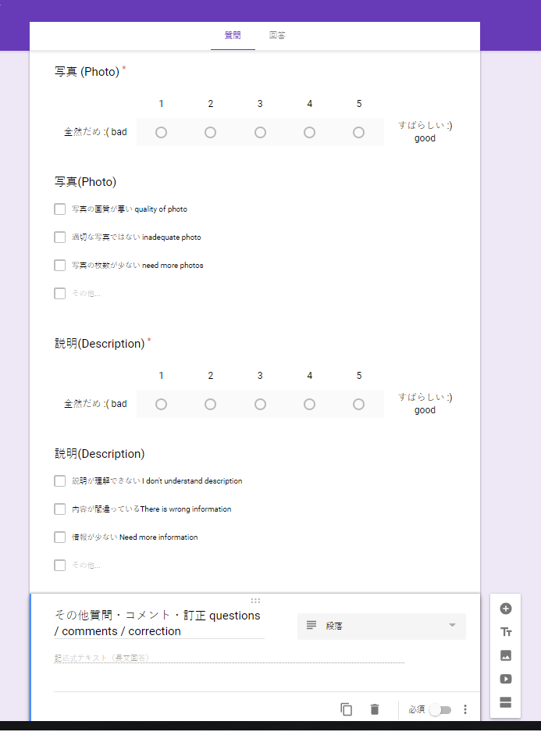

Slide 10
Steps
Students are divided into three groups (city centre, old town and other parts)
Teacher demonstrates the usage of ICT tools (google my map, google form)
Students pin on the shared map and upload photos and short scripts of some spots in their responsible area. - one week
Students read other group areas’ descriptions as proofreading of grammars and facts and give evaluation by google form. – one week
Communicate with native Japanese students via online to correct grammars and add more information. - one week
Teacher looks though students’ map and open in public.
Students improve and update map when they find something new and they receive comments and questions from readers – until the end of semester

Slide 11
Criteria / weight - 10P
Pinning spots with photo and description (1p*3 spots=3p) – individual
Improvement and addition by working with Japanese students (1p*3 spots=3p) – working with reviewer
Suggestions for other groups’ spots by proofreading (2p) – working with group
Improvement and addition after publication (2p) - individual

